Slide 1
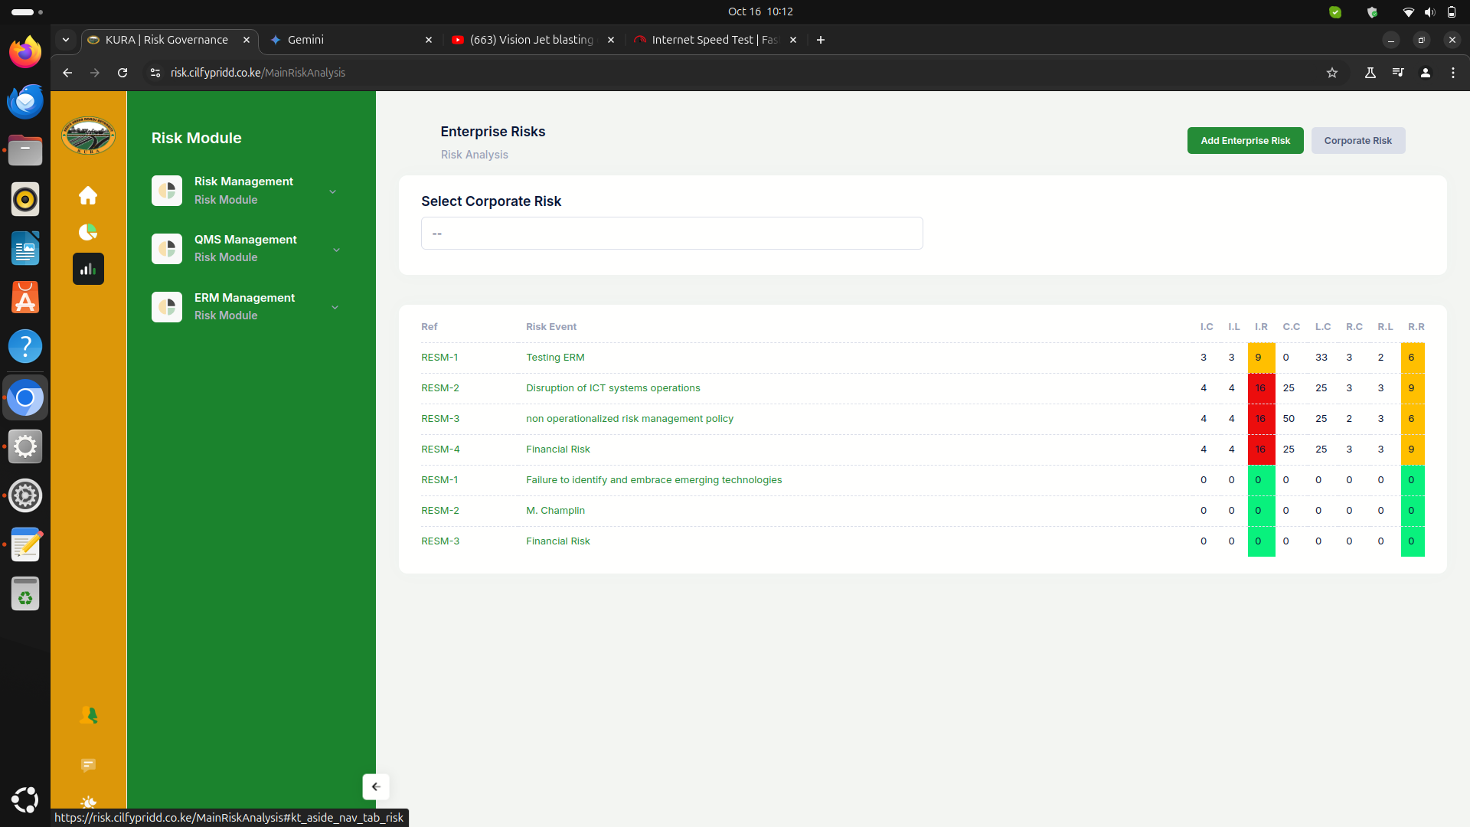
Remove the list populating below if no corporate risk is selected.

Slide 2
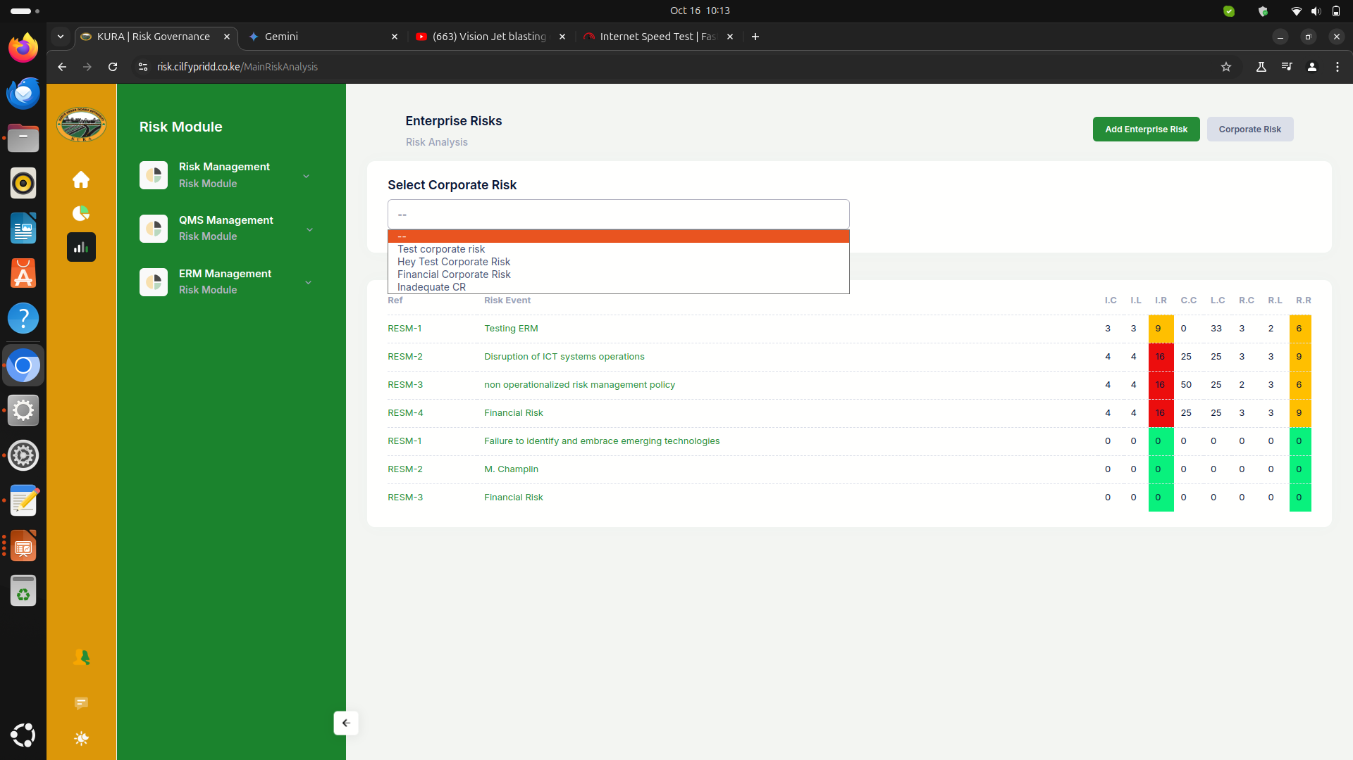
Select multiple from drop down

Slide 3
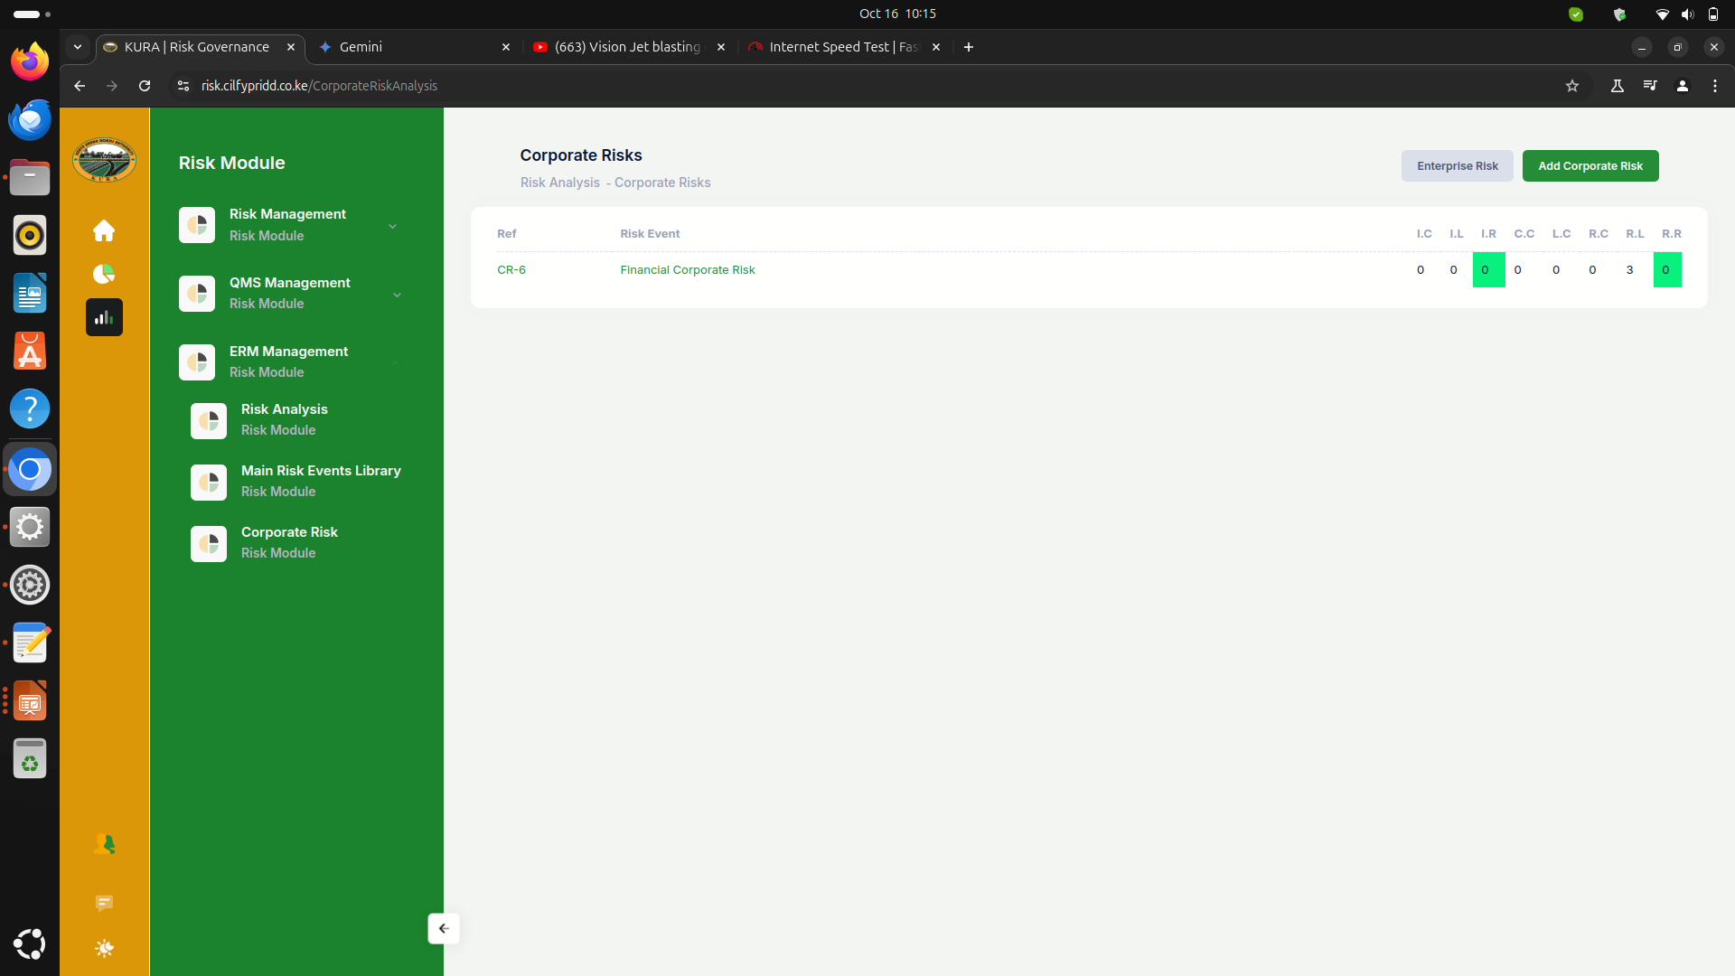
Add corporate risk ranking on top of it similar to image shared.

Slide 5
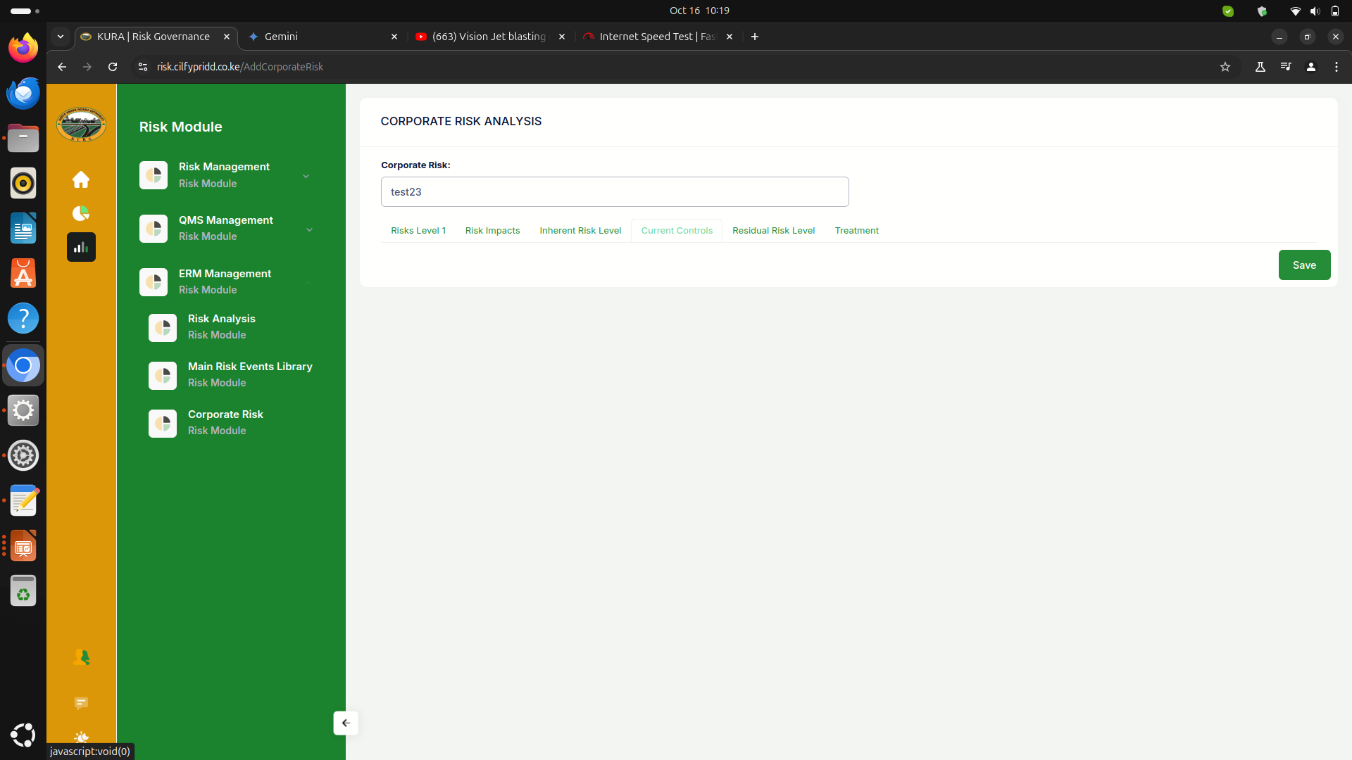
Remove all risk level 1 and impacts and replace with a list of risk events can be selected multiple

Slide 6
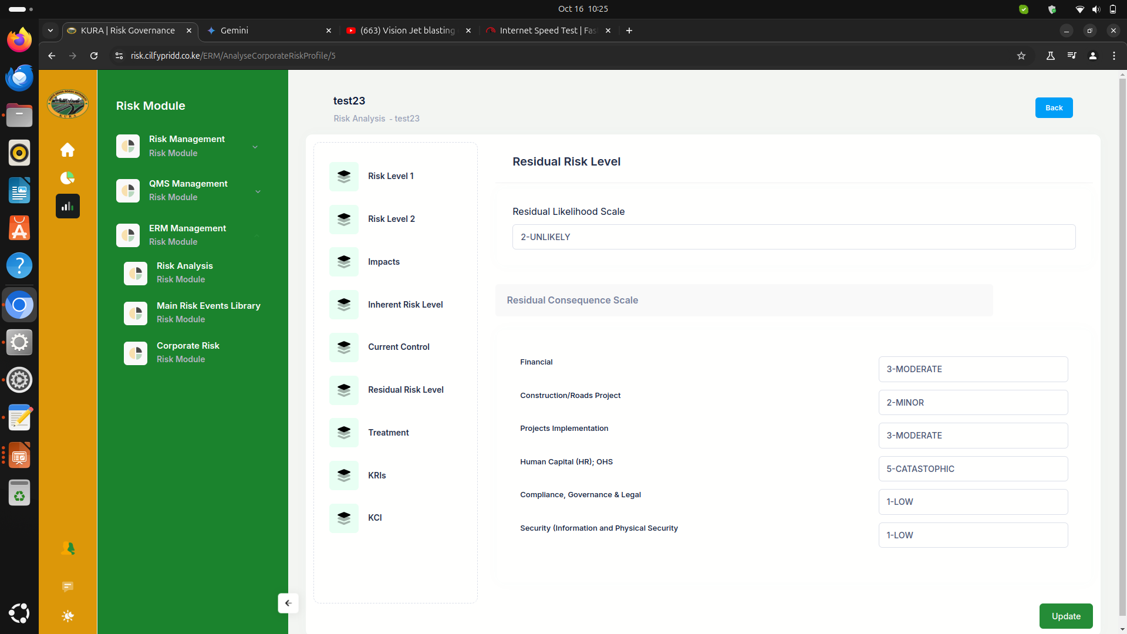
Remove all apart from inherent and residual risk and add risk events list

Slide 7
reports

Slide 8
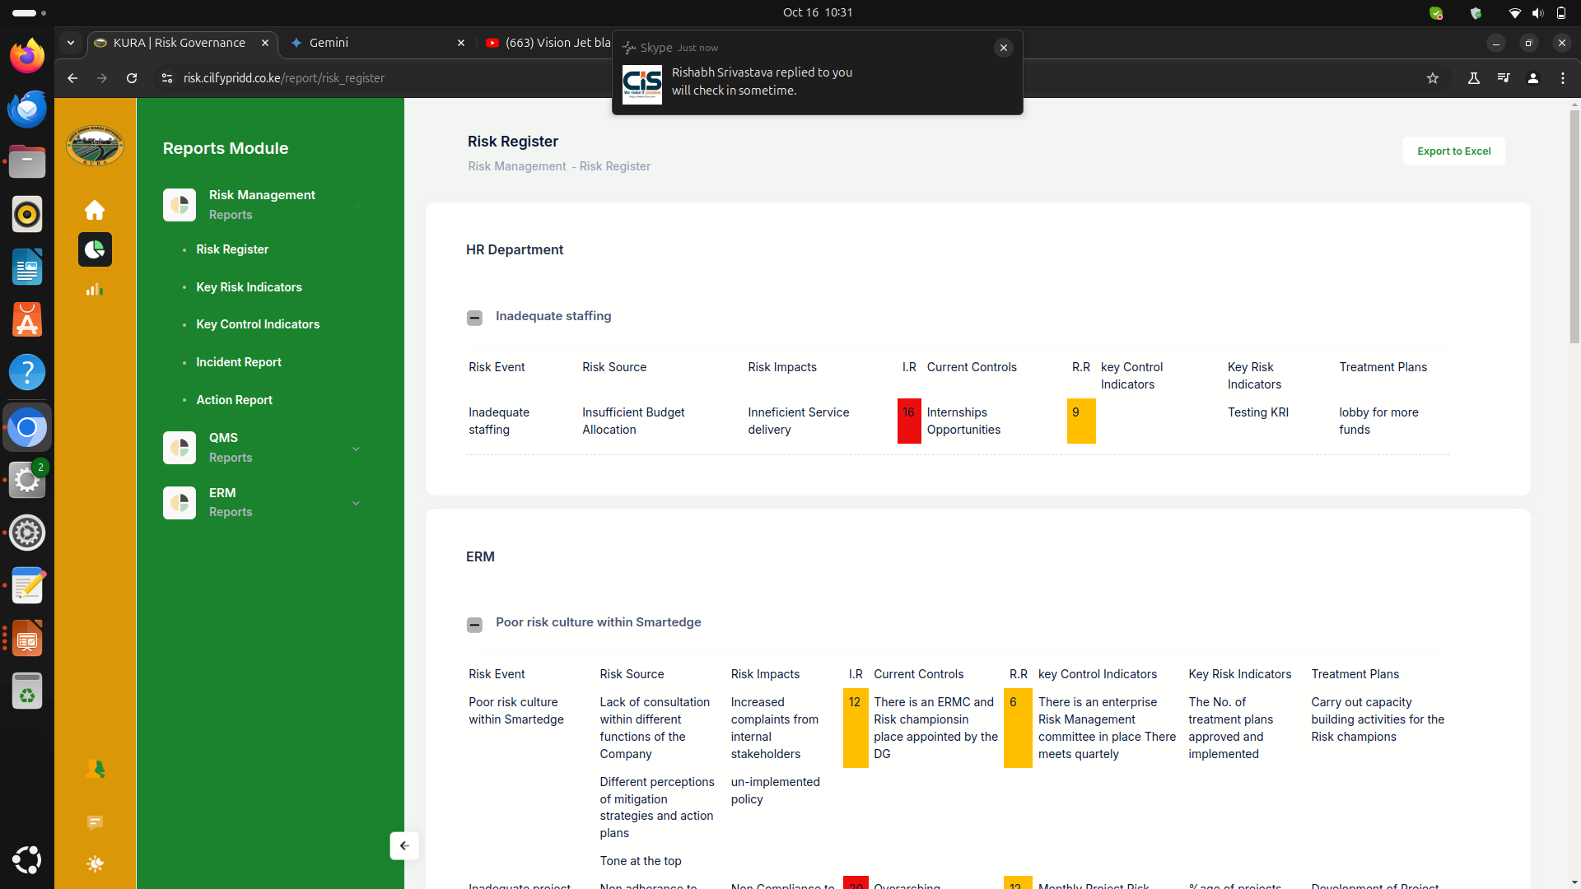
Have the reports view change to remove the drop down and be fully visible as below, add filter by department from drop down.

Slide 9
notification
Have actions assigned and linked to the action related to the notification.
Resource center /tutorials.
Uploads of data through csv, excel
Rename treatment milestones to sub-activities.

